Slide 1

Tentative Title: Integrative Trajectory Forecasting for Autonomous Vehicles in Mixed Traffic Environments
Department of Computer Science & Engineering
Supervised By:
Md Rakibul Haque
Lecturer,
Dept. of Computer Science & Engineering, RUET.
Presented By:
Md. Nazmul Hossain ID : 1803170

Slide 2
Topic Outline
Introduction
Literature Review
Challenges
Objectives
Methodology
Dataset Details
Results
Conclusion
Future Work
References

Slide 3
Introduction
Trajectory refers to a path that a vehicle moves through space over time.
For of an autonomous vehicle, trajectory not only the route but also it’s motion—speed, acceleration, and direction etc.
Fig – 1: Some trajectories of various vehicle [5]

Slide 4
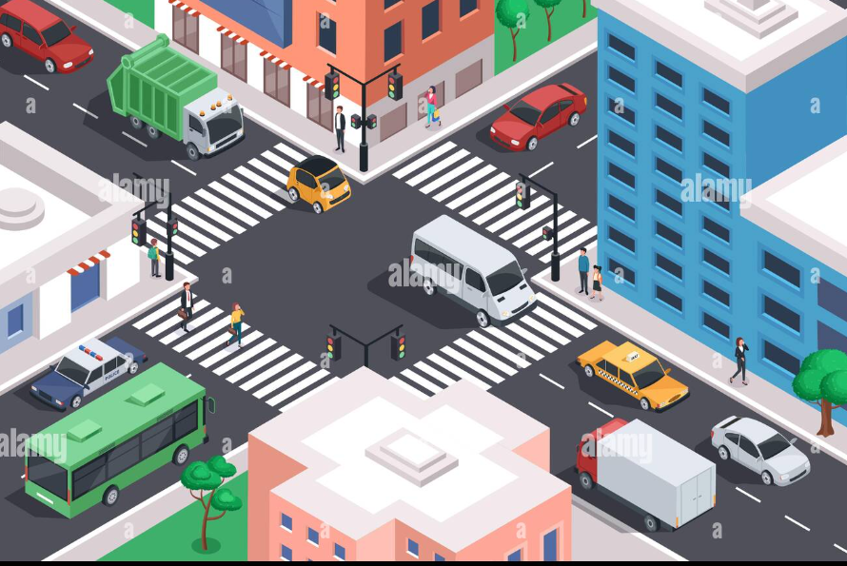
Introduction (CONT’D)
Mixed traffic environment consists of different types of road users, such as pedestrians, bicycles, motorcycles, cars, and buses, share the same space and interact with each other.
Fig – 2: Mixed Traffic Environment [1]

Slide 5
Literature Review
TrafficPredict: Trajectory Prediction for Heterogeneous Traffic-Agents [2]
Performances:
Using previous state-of-the-art approaches in accuracy for trajectory prediction in heterogeneous traffic
Offer real-time performance without assumptions about traffic conditions or the number of agents.
Limitations:
The accuracy varies with traffic conditions and the historical data available.
Future improvements will consider additional constraints such as lane directions, traffic signals, and rules.

Slide 6
Literature Review (CONT’D)
Interactive Trajectory Prediction for Autonomous Driving via
Recurrent Meta Program Induction Network [3]
Performances :
Use traditional kernel methods in predicting the trajectory of human-driven cars, achieving lower mean error rates in trajectory prediction for both longitudinal and lateral directions.
Limitations:
Future developments are needed for a more advanced generator and observer structure to further reduce prediction errors and to extend the framework to more general scenarios, such as turns at intersections and highway merging.

Slide 7
Literature Review (CONT’D)
Probabilistic Trajectory Prediction for Autonomous Vehicles with Attentive Recurrent Neural Process [4]
Performances :
The Attentive Recurrent Neural Process (ARNP) proposed in the paper effectively captures sequential information traffic scenarios.
ARNP outperforms several previous approaches in terms of prediction accuracy, variance, and probability expressiveness by predicting an explicit distribution.
Limitations:
Future developments are needed for better recognize and adapt to poorly understood traffic.

Slide 8
Challenges
Work on Urban Areas
Deals with Mixed Traffic Agents
Reduce Prediction Error

Slide 9
Objectives
Deals with mixed traffic environment consists of various cars, bicycles, bikes, buses, pedestrians, traffic lights etc in an urban areas.
Also increasing the accuracy of the model is an obligatory part of my work.

Slide 10
Methodology
4D Graph Generation
Apply LSTM Based Model
LSTM Model Train with Dataset
Instance Layer
Category Layer
Prediction Generation
Model Evaluation

Slide 11
Proposed Methodology
4D Graph Generation
Create Two Map
Apply LSTM
Instance Layer
Category Layer
Horizon Map
Neighbor Map
Apply CNN
Reduce Prediction Error
Model Evaluation & Refinement
Prediction Generation

Slide 12
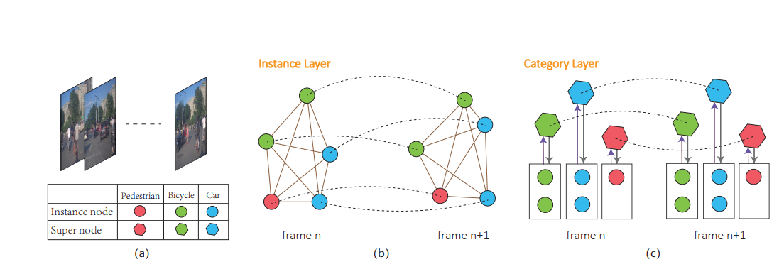
Methodology (CONT’D)
4D Graph Generation
Fig – 3: (a) Sample image frames of various traffic agents, (b) Instance layer graph between two frames, (c) Category layer supernode creation and graph. [5]

Slide 13
Methodology (CONT’D)
Instance & Category Layer
Frame (t)
Frame (t+1)
Instance Layer
Category Layer
Instance Layer
Category Layer

Slide 14
Methodology (CONT’D)
Two Maps
Horizon Map
Neighbor Map
Ego Agent
LSTM
Conv1
Conv2
Conv2
+
LSTM
Output
LSTM
Conv1
LSTM
Conv1
Conv2
Fig – 4: LSTM-CNN Architecture

Slide 15
Dataset Details
Dataset Name: ApolloScape Dataset
It contains 53 file, each file for 1 min sequence with 2 fps (frame per second) rate.
Attribute | Description
Frame_id | It indicates a unique frame of a video stream which is captured on 2fps rate.
Object_id | It indicates the unique object.
Object_type | It indicates the type of an object such as vehicle, bicycle, pedestrian or other.
Position_x,y,z | The position x,y,z indicates the location of an object in world coordinate system.
Object_length | It indicates the length of an object.
Object_width | It indicates the width of an object.
Object_height | It indicates the height of an object.
Heading | The heading value is the steering radian with respect to the direction of the object.
[5]

Slide 16
Dataset Details
Dataset Name: TRAF Dataset
Attribute | Description
Frame_id | It indicates a unique frame of a video stream which is captured on 2fps rate.
Num_agent | It indicates the number of agents of this frame.
Position_x,y | The position x,y indicates the ground truth value of an agent in world coordinate system.
Agent_length | It indicates the length of an agent.
Agent_width | It indicates the width of an agent.
Agent_name_id | It indicates the type of an agent with an id.
[6]

Slide 17
Results
I implement the model with the ApolloScape Dataset –
Traffic Agent | ADE | FDE
Pedestrian | 1.1427719593048096 | 0.9647185802459717
Bicycle | 1.0993574857711792 | 0.9176489114761353
Car | 1.3722141981124878 | 1.3418755531311035
Average Displacement Error (ADE) | 1.2047812938690186
Final Displacement Error (FDE) | 1.0747476816177368

Slide 18
Conclusion
In conclusion, we have successfully implemented the existing model and evaluated the results. However, we have identified certain limitations in the existing approach, including the absence of considerations for dynamic motion, turning radius, and driver behavior. To address these shortcomings and enhance the model's capabilities, our proposed model incorporates these crucial characteristics, paving the way for a more comprehensive and accurate solution.

Slide 19
Future Work
Apply the Hybrid Model on another Dataset and Observe the result
Combine the prediction result of all existing traffic agent and try to give suggestion our vehicle trajectory

Slide 20
References
[1] https://c8.alamy.com/comp/2GDM3KX/isometric-city-crossroad-with-cars-road-intersection-traffic-jam-urban-downtown-street-with-transport-and-people-vector-illustration-public-and-private-transport-in-residential-area-2GDM3KX.jpg
[2] Yuexin Ma, Xinge Zhu, Sibo Zhang, Ruigang Yang, Wenping Wang, Dinesh Manocha4
[3] Chiyu Dong, Yilun Chen and John M. Dolan
[4] Jiacheng Zhu, Shenghao Qin, Wenshuo Wang, Member, IEEE, and Ding Zhao
[5] https://apolloscape.auto/trajectory.html
[6] https://gamma.umd.edu/researchdirections/autonomousdriving/trafdataset

Slide 21
Thank You

Slide 22
Q/A

